Slide 1
Emergence of Bangladesh
North South University
Dhaka, Bangladesh
HIS 103

Slide 2
Lahore Resolution/Pakistan Resolution of 1940

Slide 3
1. Who passed the Lahore Resolution?
2. Whose demand was said to be first demanding Pakistan?
3. When was the name of country first coined?
4. Who coined the term Pakistan for the first time?
5. What is the background of Lahore resolution?
6. What are the principal clauses of Lahore Resolution?
7. What is the importance of Lahore Resolution?
8. What was the impact of the Lahore Resolution?

Slide 4
Background:
Nehru reports , 1929
Fourteen points of Jinnah, 1929 [For details, please see, https://en.banglapedia.org/index.php?title=Fourteen_Points]
Communal Award, 1932
The Government of India Act, 1935
Fear of Congress rule in 1937 election
Hindu-Muslim Communal Conflicts

Slide 5
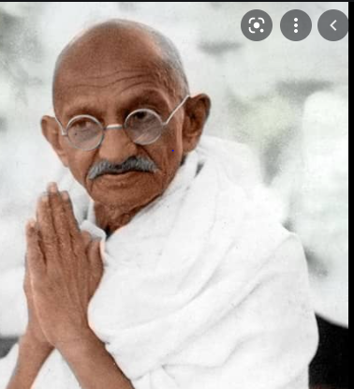
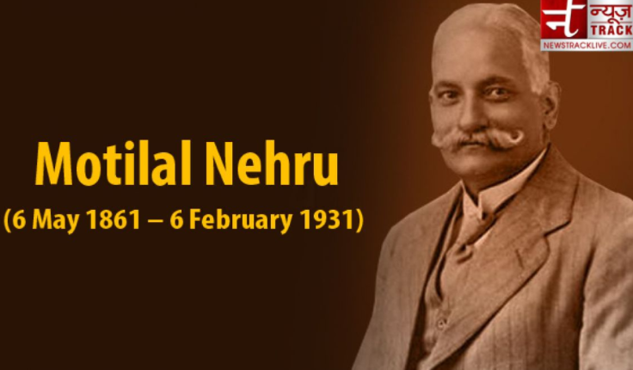
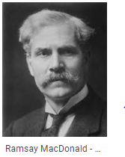
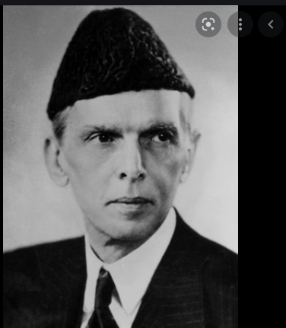
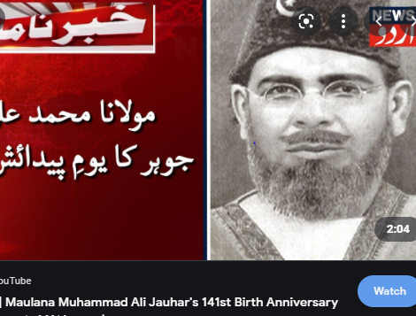
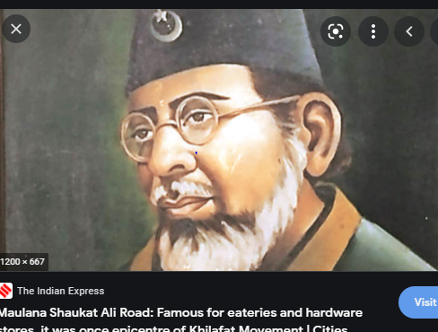

Slide 6
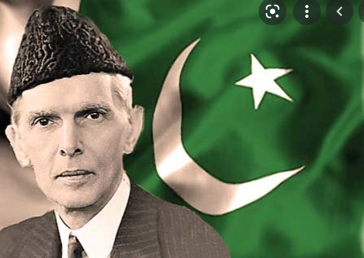
In 1940 mohammed ali jinnah called a general session of the All India Muslim League in Lahore to discuss the situation that had arisen due to the outbreak of the Second World War and the Government of India joining the war without taking the opinion of the Indian leaders, and also to analyze the reasons that led to the defeat of the Muslim League in the general election of 1937 in the Muslim majority provinces.

Slide 7

The Lahore Resolution commonly known as the ’Pakistan Resolution’ was a formal political statement adopted by the Muslim League at the occasion of its three-day general session on 22-24 March 1940 that called for greater Muslim autonomy in British India. This has been largely interpreted as a demand for a separate Muslim state, Pakistan. The resolution was presented by A. K. Fazlul Huq

Slide 8
Jinnah, in his speech, criticized the Congress and the nationalist Muslims, and espoused the Two-Nation Theory and the reasons for the demand for separate Muslim homelands. Two-Nation Theory was the basis for the Lahore Resolution.
Lahore Resolution was presented by A. K. Fazlul Haq, the then chief minister of Bengal on the 23 March , 1940.

Slide 9

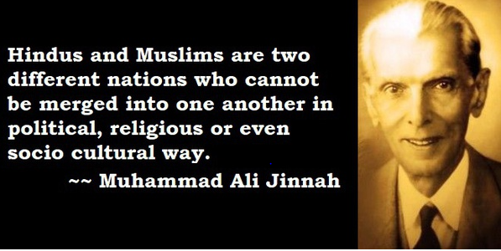


Slide 10
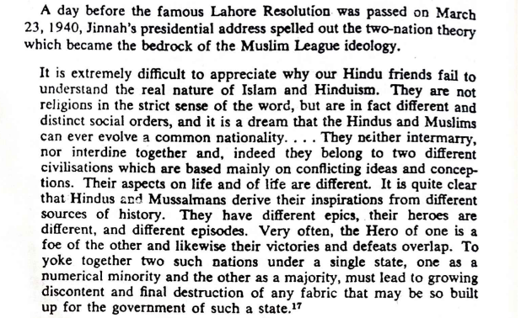
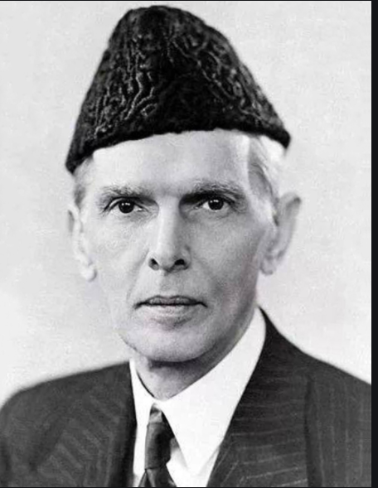

Slide 11
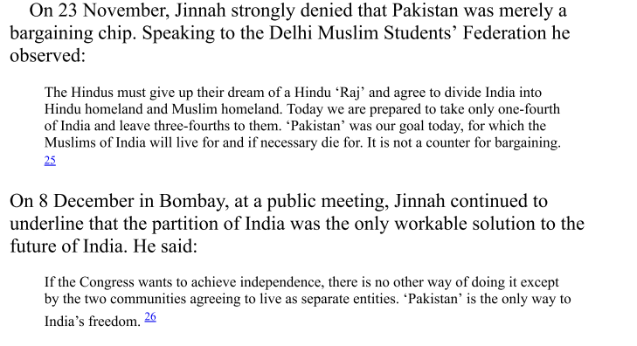

Slide 12
The Lahore Resolution ran as follows:
“That the areas in which the Muslims are numerically in a majority as in the North-Western and Eastern zones of India should be grouped to constitute 'independent states' in which the constituent units shall be autonomous and sovereign”.
( Source: K. B. Sayeed, The Political System of Pakistan, Oxford: Oxford University Press, 1967, Page 40).

Slide 13
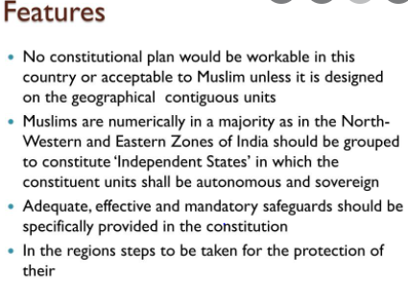

Slide 14
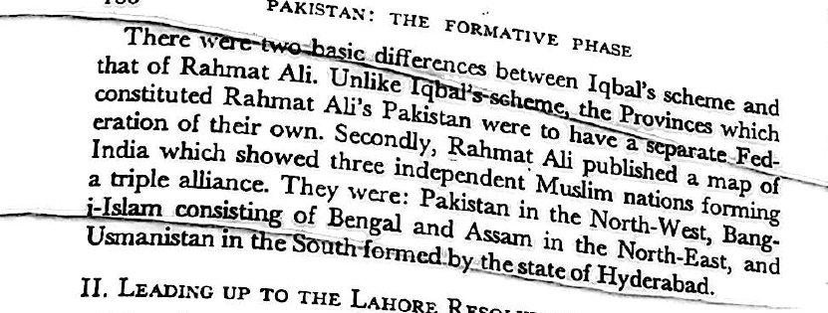
The Hindu Press dubbed it as the 'Pakistan Demand', after the scheme invented by Rahmat Ali, an Indian Muslim living at Cambridge. Choudhury Rahmat Ali , when he was a student at Cambridge, suggested the word Pakistan in a pamphlet published in January, 1933. Sir Muhammad Iqbal also advocated his Islamic ideological basis of a state.

Slide 15
With the passage of this Resolution, the Muslims of the sub-continent changed their demand from “Separate Electorates” to a “Separate State.” This Resolution rejected the idea of a United India and the creation of an independent Muslim state was set as their ultimate goal. It gave new energy and courage to the Muslims of the region who gathered around Quaid-i-Azam Muhammad Ali Jinnah from the platform of the Muslim League to struggle for their freedom.

Slide 16
Jinnah at first took the plural 's' of the Lahore Resolution as an 'obvious printing mistake'. But when, on Abul Hashim's insistence, the original minute book was checked, Jinnah found under his own signature the plural 's’.
Abul Hashim claimed that he had suggested for erasing the word 'one' and replace it with 'a'. Jinnah is said to have accepted Abul Hashim's suggestion.

Slide 17
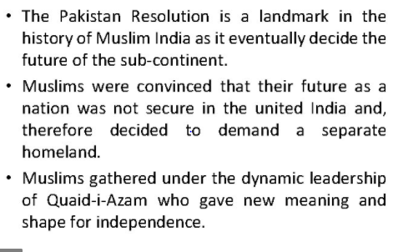

Slide 18
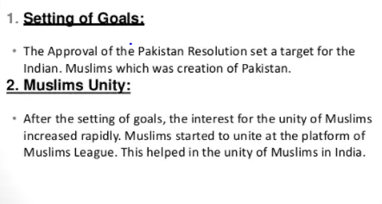

Slide 19
Reactions and pathways:
A new ray of hope for the Muslims community
Dreams for separate independent states
Majority Hindus refused the demand for separate homeland for the Muslims resulting in riots and communal violence ( “Introduction” of Anidita Ghosal)
The Lahore Resolution served as a political agenda for the ML & Muslims community
New leadership development ( Muhammad Ali Jinnah , AK Fazlul Haq)- for example, the rise of Jinnah as an ambassador of Hindu-Muslim Unity ( in 1916, Laucknow Pact) to a political leader in 1940
Growth of the Party system & aggregations of diverse interests
Seeds shown for independence

Slide 20
Suggested Books:
1. Harun or Rashid, Foreshadowing of Bangladesh: Bengal Muslim League and Muslim Politics, 1936–1947
2. K.B. Sayeed, Pakistan: The Formative Phase, 1857-1948
3. K.B.Sayeed, The Political System of Pakistan
4. Ayesha Jalal, The Sole Spokesman: Jinnah, the Muslim League and the Demand for Pakistan
5. Istiaq Ahmed, Jinnah: His Success, Failures and Role in History

